Slide 1
Housing Price Prediction
By Deepthi Prakashan

Slide 2
Introduction
Housing is one of the most basic needs of human being
The market for housing is hence increasing as a result of increase in population, migration of people to new cities etc.
For the real estate market to thrive, it is essential for investors to evaluate a locality’s acquiring and selling price so the can invest accordingly.
Machine learning this helps in this regard by helping the investors understand the trend in prices of a locality.
However, sale price of houses are heavily influenced by various attributes , many of which are local factors .
Thus we need to design a model that is adhering to that locality.

Slide 3
Problem statement
A US-based housing company named Surprise Housing has decided to enter the Australian market. The company uses data analytics to purchase houses at a price below their actual values and flip them at a higher price. For the same purpose, the company has collected a data set from the sale of houses in Australia. The data is provided in the CSV file below. The company is looking at prospective properties to buy houses to enter the market and decide whether to invest in them or not. For this company wants to know:
Which variables are important to predict the price of variable?
How do these variables describe the price of the house?

Slide 4
Workflow
Importing libraries and Dataset
Data Pre-processing
Data Visualization
Building Models (Decision Tree, Random Forest, GradientBoosting, AdaBoost,Ridge)
Model Evaluation and (R2 Score, MSE,RMSE, MAE)
And Cross Validation
Saving Model and Predicting Test data

Slide 5
Exploratory Data Analysis
We are given with Housing prices datasets, one for training the model and the other for testing the model in csv file format which was imported into the Jupyter Notebook
Train dataset consists of 1168 row and 81 columns.
Since we are required to predict the sales price, which is a regression problem, our test data set does not contain the sales price. So there are 292 rows and 80 columns in the test dataset.

Slide 6
Descriptive Statistics:
describe() function gave us an overall summary of the dataset.
Most of the features were observed to be right skewed.
BsmtFinSF2,LowQualFinSF,BsmtHalfBath,EnclosedPorch,3SsnPorch,ScreenPorch,PoolArea,MiscVal have about 75% data with zero values.
Maximum sale price was found to be 755000 where as minimum was 34900
Using info() function, we found the dataset consisted of the dtypes we observe are datetime64[ns](3), float64(2), int64(32), object(44). We could observe missing values in the columns.
Value_counts() function was then used for seeing the categories in each of the categorical columns.

Slide 7
Data Cleaning
Id is an identifier, hence the column was dropped
Utilities have only 1 value in train dataset, which is not useful for the analysis
Handling zero and Missing values:
Alley, PoolQC and MiscFeature has 90% above values missing. MiscVal (96.404110), PoolArea (99.400685), ScreenPorch (91.866438), 3SsnPorch(98.116438), LowQualFinSF (98.030822), BsmtHalfBath (94.606) had above 90% of the values as zero.
These columns were dropped since there is nothing much the model can learn from these features
After dropping unnecessary column we are left with 67 features.
Missing values in the remaining categorical features were replaced by ‘None’. For MasVnrArea, the missing values were replaced by zero. And for remaining numeric column kNN Imputer was used.

Slide 8
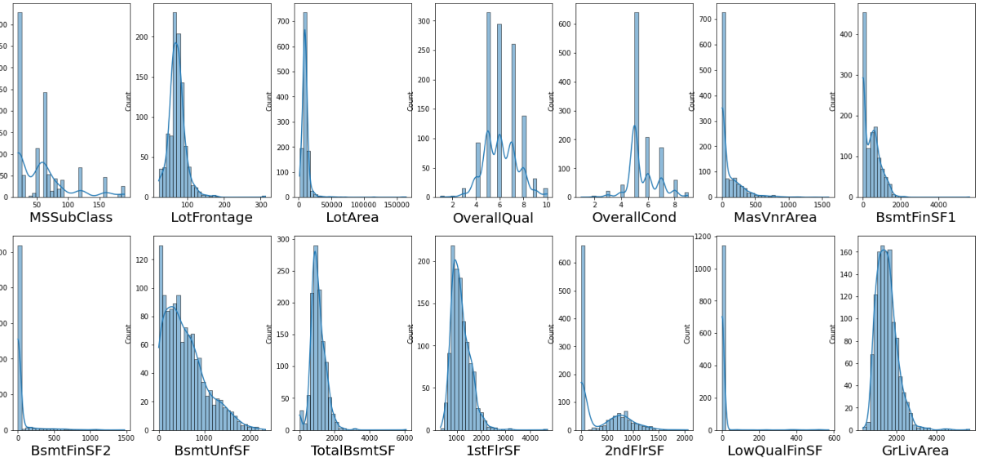
Data visualization
Distribution of numerical variable
We can observe that numerical variable consists of both discreet and continuous data.
Continuous variables: LotFrontage, LotArea, BsmtFinSF2,BsmtUnfSF,TotalBsmtSF,1stFlrSF, 2ndFlrDF,LowQualFinSF,GrLivArea, GarageYrBlt, GarageArea, WoodDeckSF, OpenPorchSF, EnclosedPorch
Discreet variables: OverallQual, OverallCond, BsmtFullBath, BsmtHalfBath, FullBath, HafBath, BedroomAbvAvg, KitchenAbvGr, ToRmsAbvGRd, Fireplaces, GarageCars,MoSold
Here we can observe all the continuous variables are right skewed.
Features like BsmtFinSF2,LowQualFinSF mostly contain the value 0 as observed in the graph

Slide 9
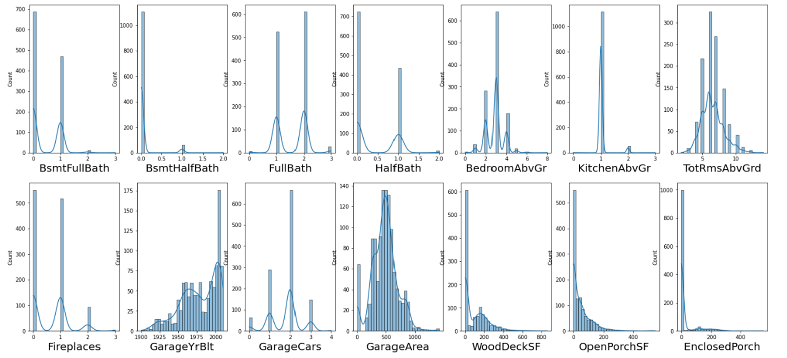
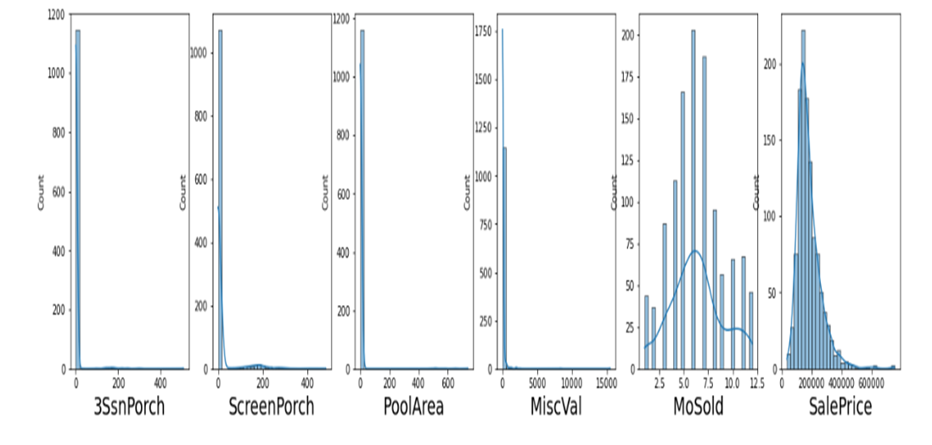
Apart from GarageYrBlt which is left skew, rest of the continuous variable here are right skewed
EnclosedPorch,3snPorch,ScreenPorchPoolAreaMiscVal is also seen to have maximum values to be zero.
These columns have above 90% of the values as zero: MiscVal (96.404110), PoolArea ( 99.400685), ScreenPorch (91.866438), 3SsnPorch(98.116438), LowQualFinSF (98.030822), BsmtHalfBath (94.6061)
Sale Price which is the target variable is observed to be slightly skewed to the right. The maximum value was found to be and minimum to be

Slide 10
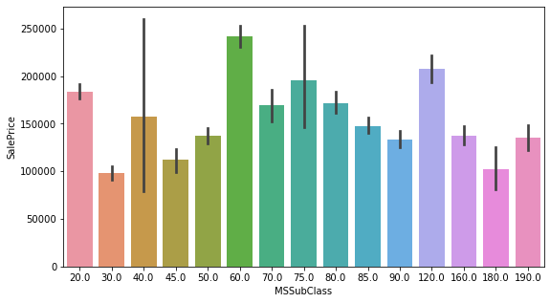
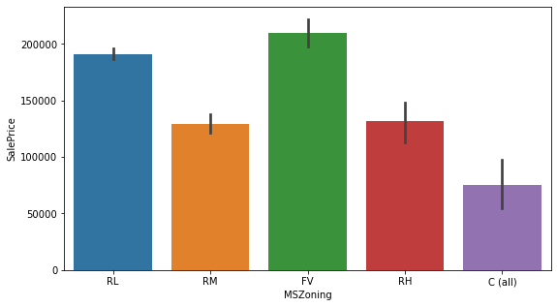
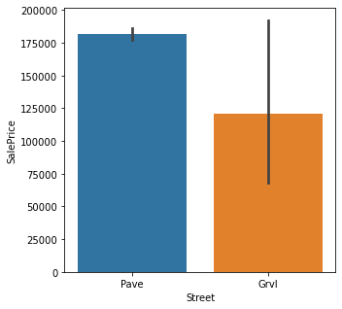
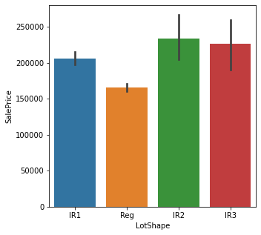
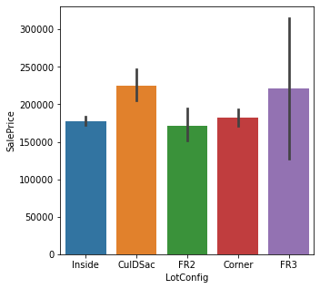
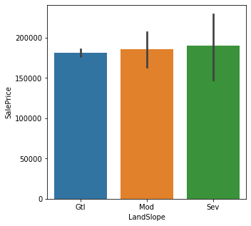

Slide 11
MSSubClass: 60 : which is a 2-STORY 1946 & NEWER are seen to be to be priced the most
MSZoning: FV Floating Village Residential, RL Residential Low Density are on the pricier side. C(all) is priced the least
Street: We can asee that on average houses with gravel roads are monstly priced less, but we can observe a long error bar suggesting that the prices for the street with gravel roads have values that are highly variable from the mean price.
LotShape: I f we look at the distribution for each, a lot of houses are Reg, but they are mostly priced less than 200000. IR2 and IR3 which are rare are found to be in a price range greater than 20,0000.
LotConfig: CulDSac is seen to be more on the costly side.
LandSlope: There is not much difference seen with respect to the price.

Slide 12
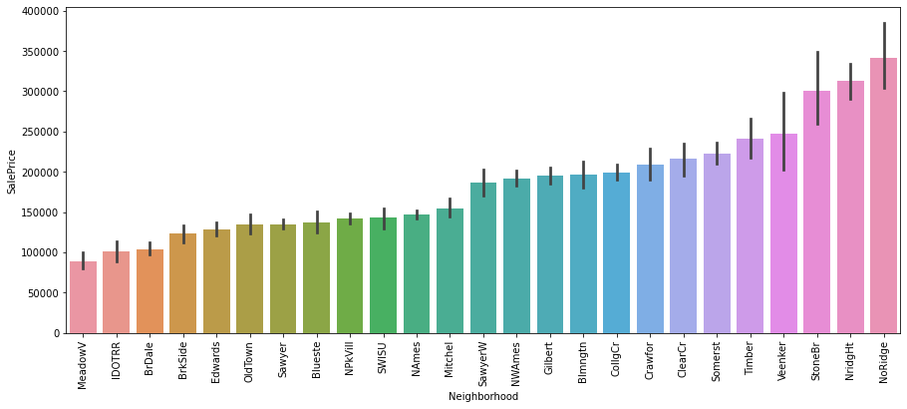
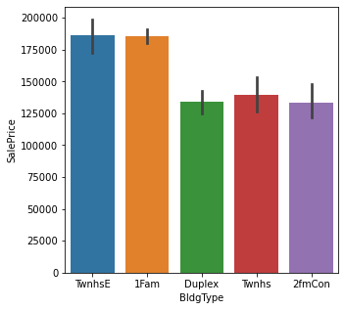
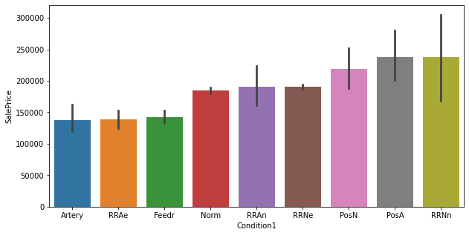
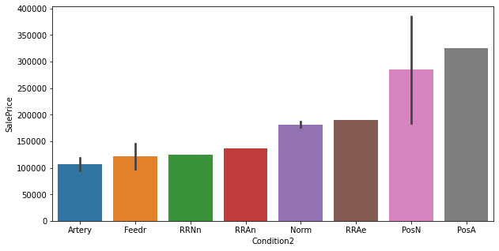

Slide 13
Neighborhood: NoRidge,NridgHt are on pricier side where as MeadowV, IDOTRR, BrDale are cheap.
BlidgType : Duplex. Twnhs, 2fmCon price race is comparatively less tha TwnhsE and 1Fam
For Condition 1 Feedr, RRAe and RRAe falls on cheaper side where as RRNn and PosA are pricey
Condition 2 Artery falls on cheaper side. PosA houses have high sale price

Slide 14
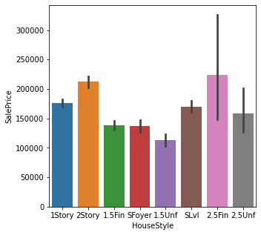
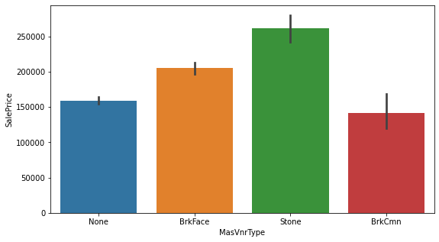
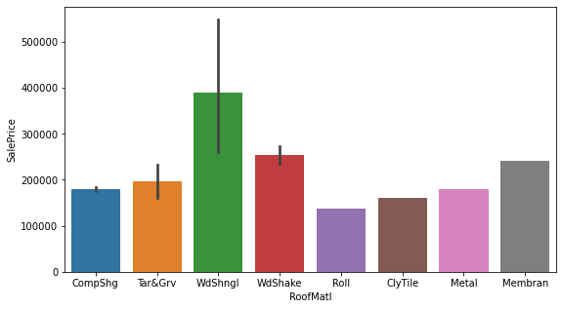
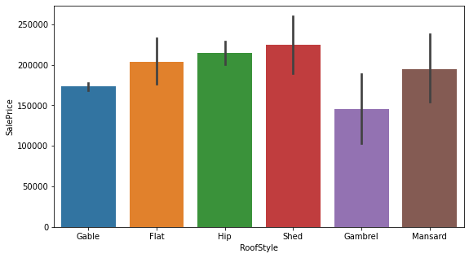

Slide 15
HouseStyle : 2Story are price higher, 2.5 Fin is also price higher however the variability in prices is high. 1.5Unf is the cheapest.
MasVnrTyp: While BrkCmn is the cheapest, Stone has high sale price.
RoofMatt: House with roll are cheaper whereas WdShngl are pricy
RoofStyle: Overall Shed has high sale price.

Slide 16
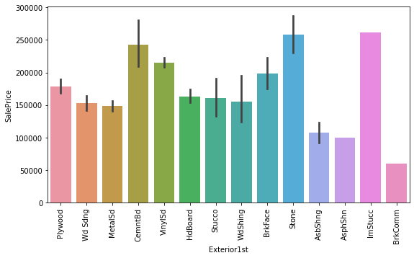
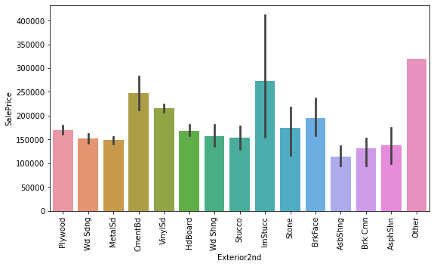
Exterior1: BrkComm are priced the cheapes whereas lmStreet have high sale price.
Exterior 2: AsbbShng are priced cheaper.

Slide 17
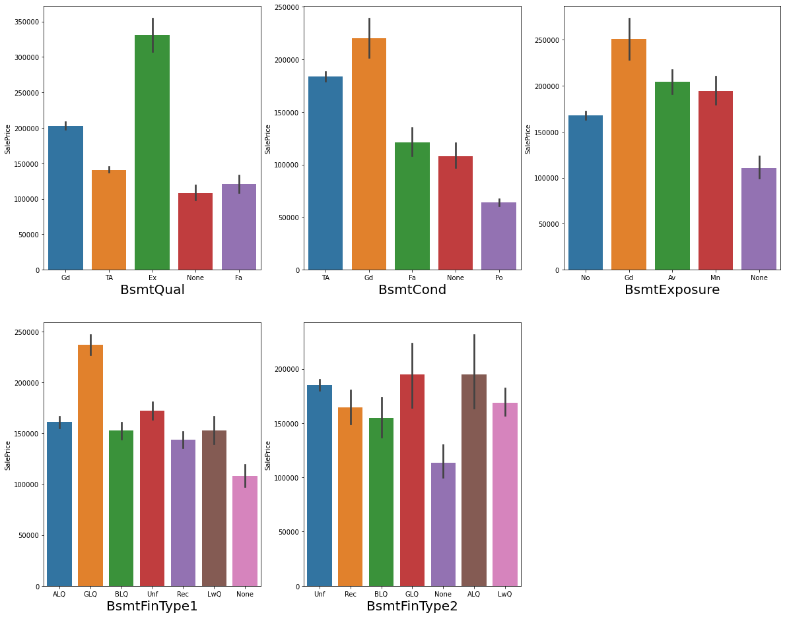

Slide 18
BsmtQual: Houses with no basements are cheaper. Those rated as excellent have sale price.
BsmtCond: House rated as poor for BsmtCond are priced less, while those price as Good have high sale price.
BsmtFinType1: GLO is seen to have high sale price as per the plot.Rest are almost in the same range.
BsmtFinType2: GLO and ALO have high sale price.

Slide 19
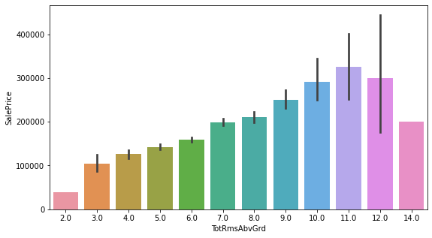
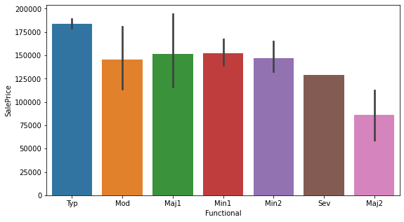
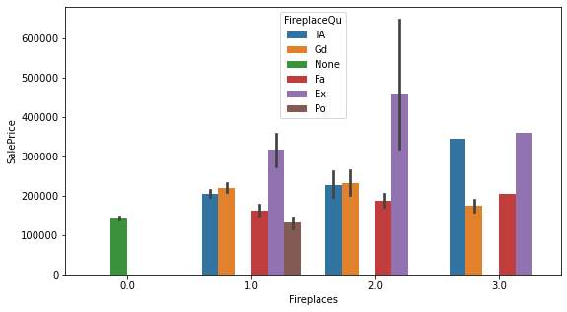

Slide 20
TotRmsAbvGrd:11 has high sale price. 2 is the cheapest.
Functional: Type has high sale price whereas Maj2 have less price
Fireplace: Places with no fireplaces are the cheapest. Those with 2 fireplace have comparatively higher sale price, especially those rated as excellent.

Slide 21
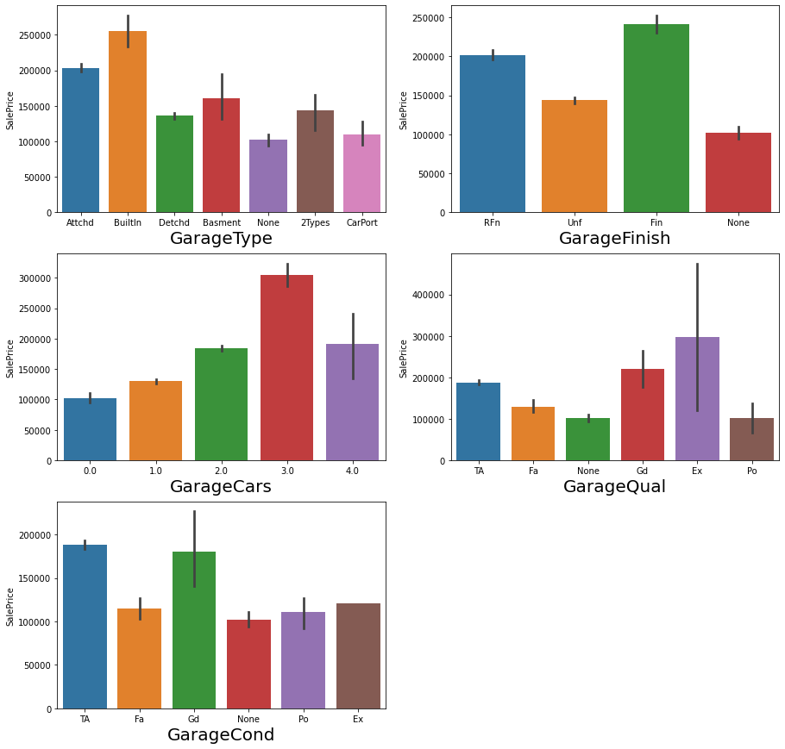

Slide 22
GarageType: BuiltIn houses have higher sale price. Those that have no garages are priced lowest.
GarageFinish: Fin are priced highest.
GarageCars: Houses with 3 garage cars are price high. Those with none are priced the lowest
GarageQual: Those rated as Excellent have high price rate buth the variability seen in price is high as well.
GarageCond: TA and Gd are priced high whereas rest are of the same range.
Overall we can see that houses with no garages are cheaper.

Slide 23
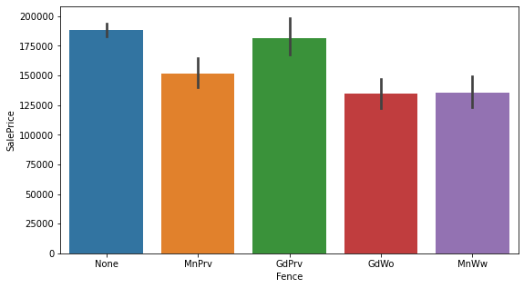
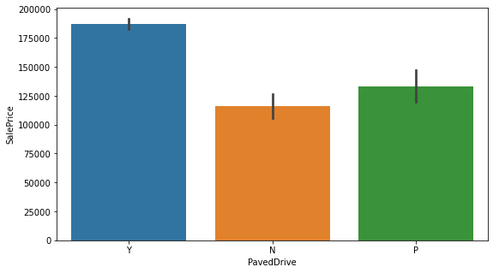
Fence: Houses with no fences are seen to have slightly higher sale.
PavedDrived: Houses with paved drive are priced high

Slide 24
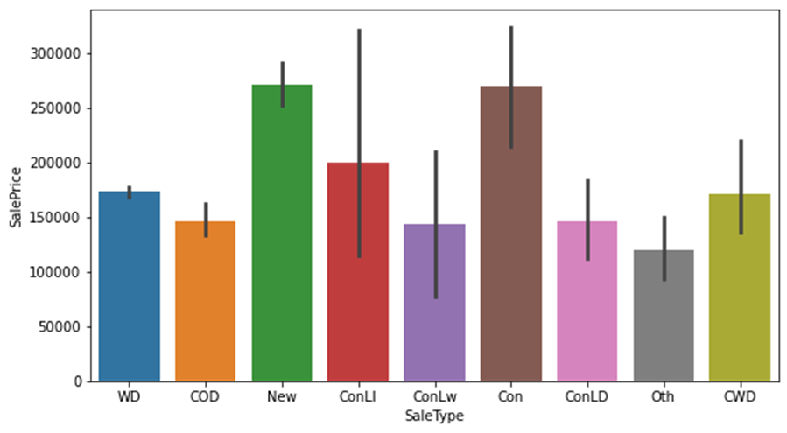
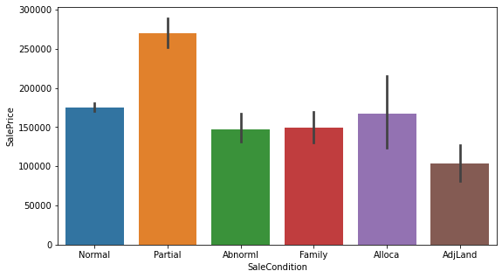
SaleType: New houses are seen to have high sale price
SaleCondition: Those with partial sale condition have high sale condition while AdjLand are seen to be cheaper

Slide 25
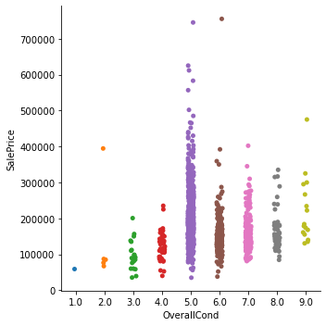
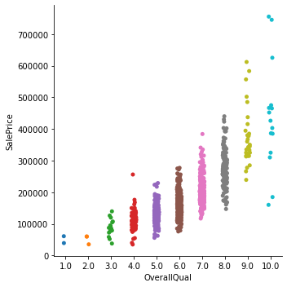
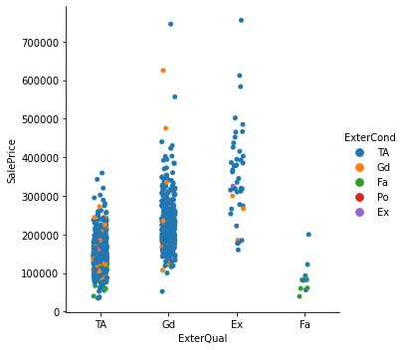
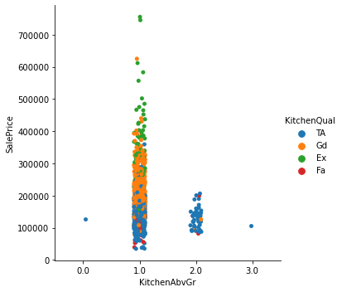

Slide 26
OverallCondition : Houses with overall condition are seen to be most popular among buyers and are seen to have more houses at higher sale price though houses at
OverallQual: We can observe a steady increase in prices as the rating increases.
KitchenAbvGr:No of kitchens does not affect the increase in sale price, however quality does affect. Houses with 1 kitchens are seen more frequent, in which all ranges are seen. Those rated as Excellent quality have higher sale price.

Slide 27
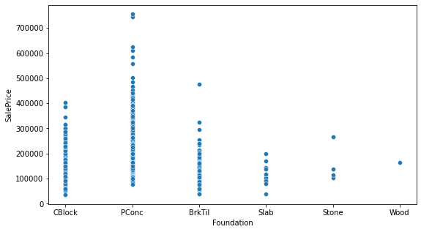
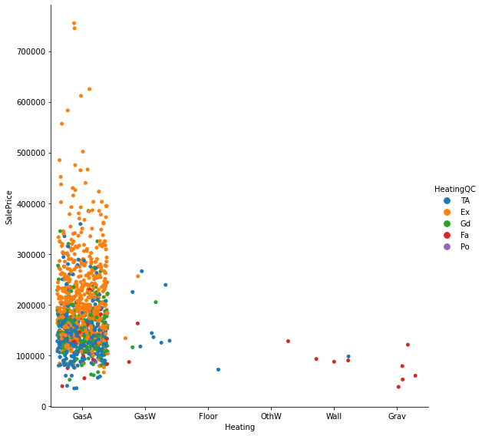
Foundation: Pconc is seen to have higher sale price
Heating: GasA is seen to be used more and those rated excellent are seen to be having higher sale prices

Slide 28
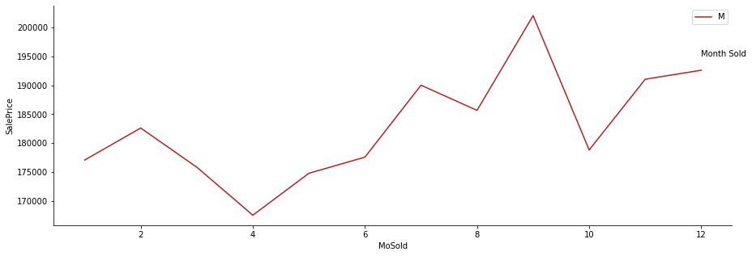
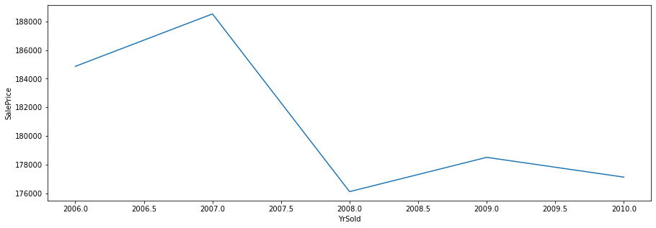
We can observe price hike in the 9th month
Sale Price was seen to have a steep decline from 2007 when the house was sold

Slide 29
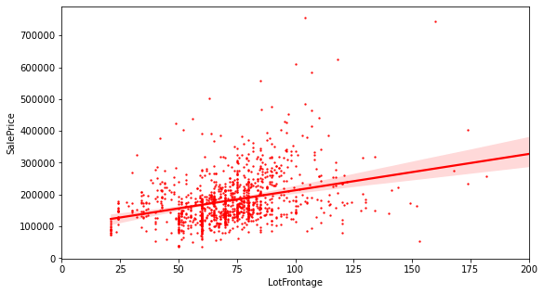
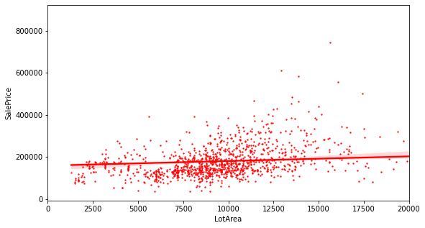
We can observe positive correlation between LotFrontage and SalePrice
Lot Area and sale price does not seem to have much correlation between each other

Slide 30
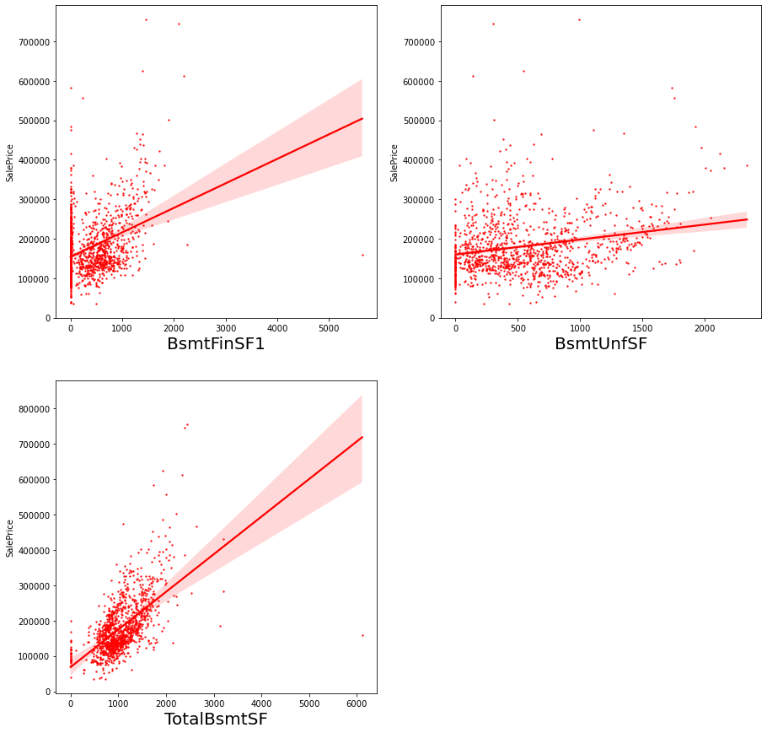

Slide 31
BsmtFinSF1: Based on the plot it appears sale price is positively correlated with BsmtFinSF1.
BsmtUnfSF is very weakly correlated with sale price as the regression line makes an angle almost close to zero.
TotalBsmtSF is also seen to be positively correlated with the sale price

Slide 32
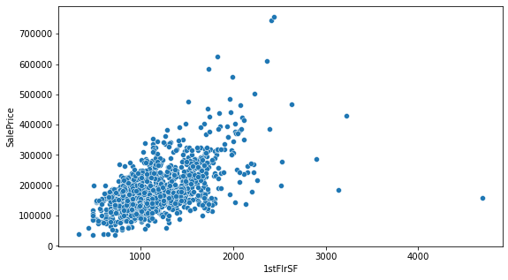
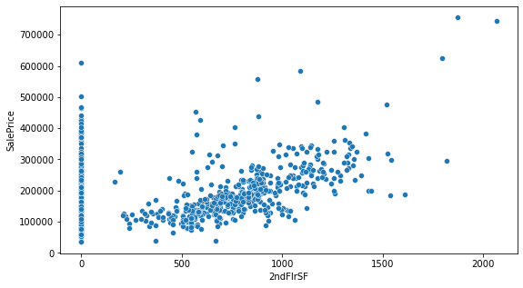
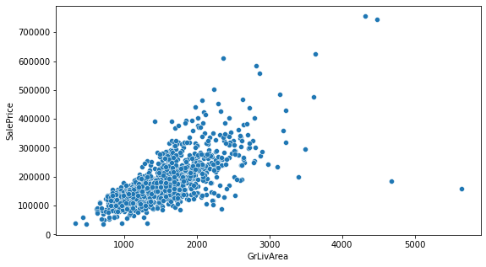
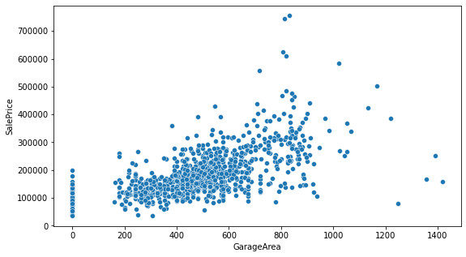

Slide 33
1stFirSF: is seen to be positively correlated with the sale price
2ndFlrSF: Is seen to be weakly positively correlated with sale price.
GrLivArea: Is seen to be strongly positively correlated.
GarageArea: is seen to be weakly correlated with sale price.

Slide 34
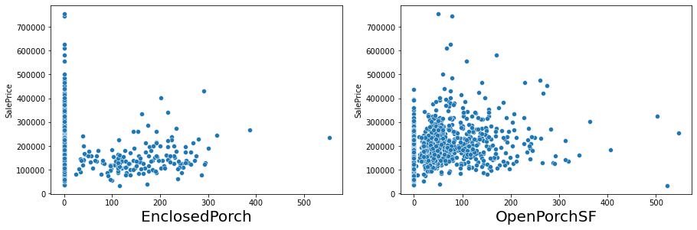
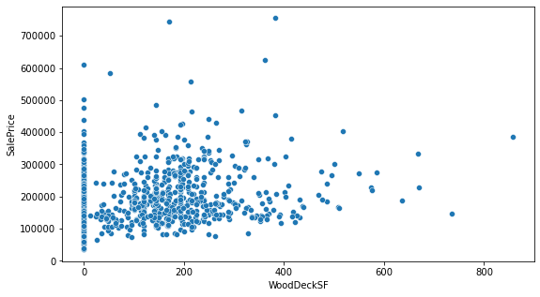

Slide 35
EnclosedPorch is seen to have no correlation with the sale price.
OpenPorchSF is positively correlated with the sale price.
WoodDeckSF as per the graph is positively correlated with the sale price.

Slide 36
Models

Slide 37
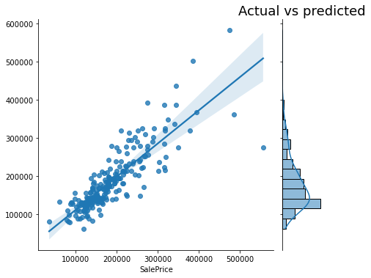
DecisionTreeRegressor
Decision tree is a non-parametric supervised machine learning model that solves both regression and classification tasks. In the case of a regression task, it splits the data such that it has a root node, which is considered the best splitting condition wherein on evaluation it gives maximum reduction in variance on splitting the data.
Here we set max_depth as 9, which restrict the trees to go only until 22. The result show the R2 score to be 71.51%. On applying evaluation metrics we found MSE to be 26826.349 and, RMSE 40044.47
. Cross validation score was 68.33%.

Slide 38
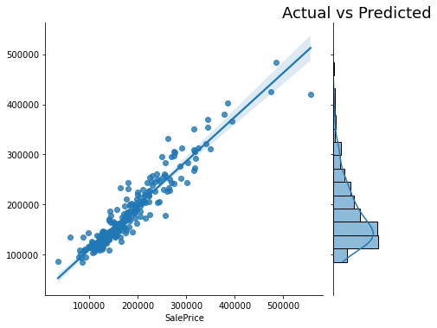
RandomForestRegressor
Random forest is a supervised machine learning algorithm that is used in solving both classification and regression problems. It is an ensemble learning technique, meaning, it creates multiple decision trees on different sample and obtain a better prediction by averaging over all the algorithms in the case of a RandomForestRegressor.
For RandomForestRegressor, we had a better R2 score of 90.19%. MSE 16243.53, RMSE 23491.89. On performing cross validation, it had a score of 83.60%

Slide 39
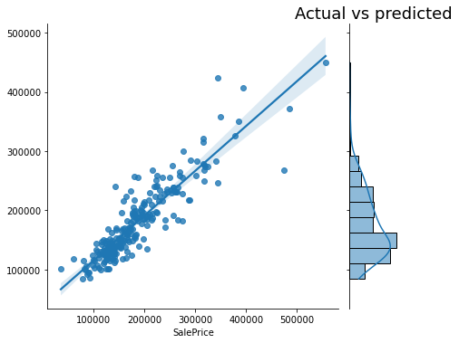
k-NN Regressor
Knn is a non-parametric supervised machine learning model that predicts the target value by averaging the values of data points that are found in its close distance. This distance can be decided up that serves well for the dataset. This method is inefficient when the dimensionality of the dataset is big.
The model performed with an R2 score of 80.38%., MSE 22387.07, RMSE 33234.95. On performing cross validation, we the score as 73.06%

Slide 40
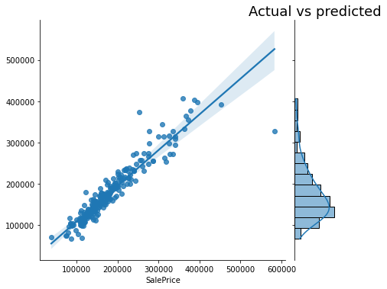
GradientBoostingRegressor
GradientBoostingRegressor is a non-parametric supervised machine learning model.It is an ensemble model that combines multiple models and obtains the prediction. It is also called an additive model as it keeps adding weak learners such that we get a stronger model from the final model.
The model performed with an R2 score of 91.10%. MSE 15571.97, RMSE 22373.66. On cross-validation, the model scored 82.86%.

Slide 41

AdaBoostRegressor
AdaBoostRegressor is a non-parametric supervised machine learning model It is an ensemble model and works on the same principle as gradientboostingregressor.
It utilizes ‘stumps’ which is a tree with a node and two leaves. Each stump is made by taking the previous stump’s error into account so some stumps have more say in taking the decision than the other.
The model performed with an R2 score of 83.35%. MSE 23408.59, RMSE 30613.71. We got 76.89 on cross-validation.

Slide 42
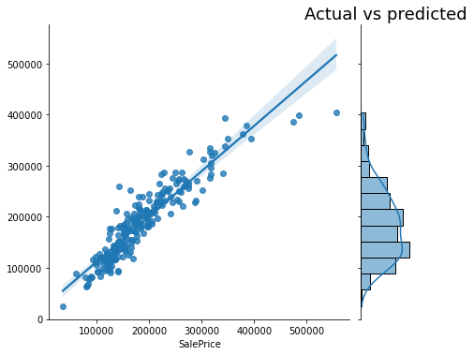
Ridge Regression
It is a type of linear regression which utilizes L2 regularization technique in order to overcome over fitting of the model. It also solves problems with high collinearity between the independent variables.
The model performed with an R2 score of 85.74% MSE 20189.37, RMSE 28329.75. On cross validation, the score was found to be 80.01%.

Slide 43

Best Model
From all the model, DecisionTreeRegressor() has the least difference in crossvalidation score vs the R2 score. So we selected it as the best model.
We the proceeded to tune the model. After hyperparameter tuning, the R2 score was improved to 74.44% from 71.51%.
We then proceeded to predict the housing sales price for test dataset

Slide 44
Conclusion
We saw that after analysis of our data, some of the important attributes that were important for our prediction were found to be
OverallQual, GrLivArea, GarageCars, GarageArea, BsmtQual and ExterQual
As OverallQual of the houses increased the sale price also increased. This also turned out to be the most important predictor in the models.
Similarly, for GrLivArea, GarageCars, GarageArea showed positive correlation with the sales price.
In the case of BsmtQual and ExterQual, they showed negative correlation with the sales price, which does not really translate much into any predictive statements regarding housing sales price.
We then to predict the models using DecisionTreeRegressor that gave an R2 score of 74.44%.

Slide 45
Thank you

